Slide 1
5-9
Tara, Amy, Platon, Anooshree

Slide 2
Table of contents
01
03
02
04
Direction/Rationale
Task Flows
Our initial designs and final choice
How our prototype accomplishes each task
Prototype
Methods and Results
What we built and tested
What we found and what we were surprised by

Slide 3
5-9
Intentionality After Work
Notes:
For new grads, dedicating purposeful time towards themselves and others can feel impossible—it’s easier to just watch Netflix every day after work. 5-9 solves this problem by making it straightforward to set, do, and reflect on intentions users set for themselves, whether it’s seeing an old friend or meditating after a long day of meetings.

Slide 4
Selected Interface and Rationale
WHAT
Mobile application
Limited notifications, all tasks available within the app
WHY
Localized solution, AKA a “one stop shop”
Integrates well with other information the user may store on their phone, like their calendar and contacts
Familiar interface and easy to access and create
Notes:
Tara
All together, we interviewed 9 participants. They were all people who’d moved away from home and started the next stage of their lives. They were all college graduates besides one and all based in the US.
We found these participants by texting older acquaintances to set up interviews and using their connections to find more interviewees. We engaged in 20-30 minute Zoom calls with our participants.
In terms of why we selected the participants we chose, we made an effort to go outside of the Stanford bubble to engage a more diverse set of perspectives. We included one Stanford grad along with people from Boulder, Washington and Lee, UCLA, and so on. This should help us avoid too much Stanford-bias in our sample. Our participants engaged in a variety of professions from tech to finance to ballet. We wanted to achieve as much diversity as possible in career path to avoid biasing our conclusions. However, given that we are all Stanford students, the people we know are already a biased dataset. Thus, there was a skew towards finance careers in our interviews, as well as top 20 colleges. We did our best to reach out to friends of friends and minimize this bias, but it’s important to admit that it’s still present in our data.

Slide 5
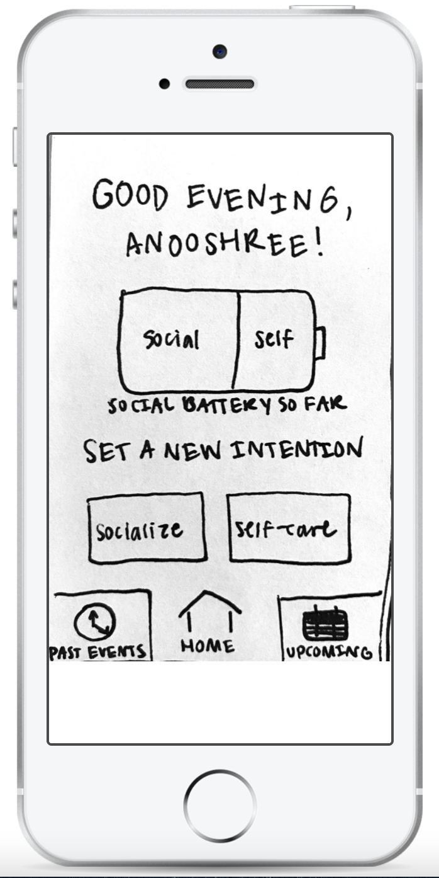
Prototype Structure
PROTOTYPE:
Handwritten-sketches transferred to POP by Marvel
Each task flow incorporated into user journey
TESTING METHODOLOGY:
Zoom call, shared computer screen
Explained basic intention behind the app, then asked users to think out loud
Asked users to walk through prototype 3 times to test learnability
Used 3 Leichhardt scale prompts

Slide 6
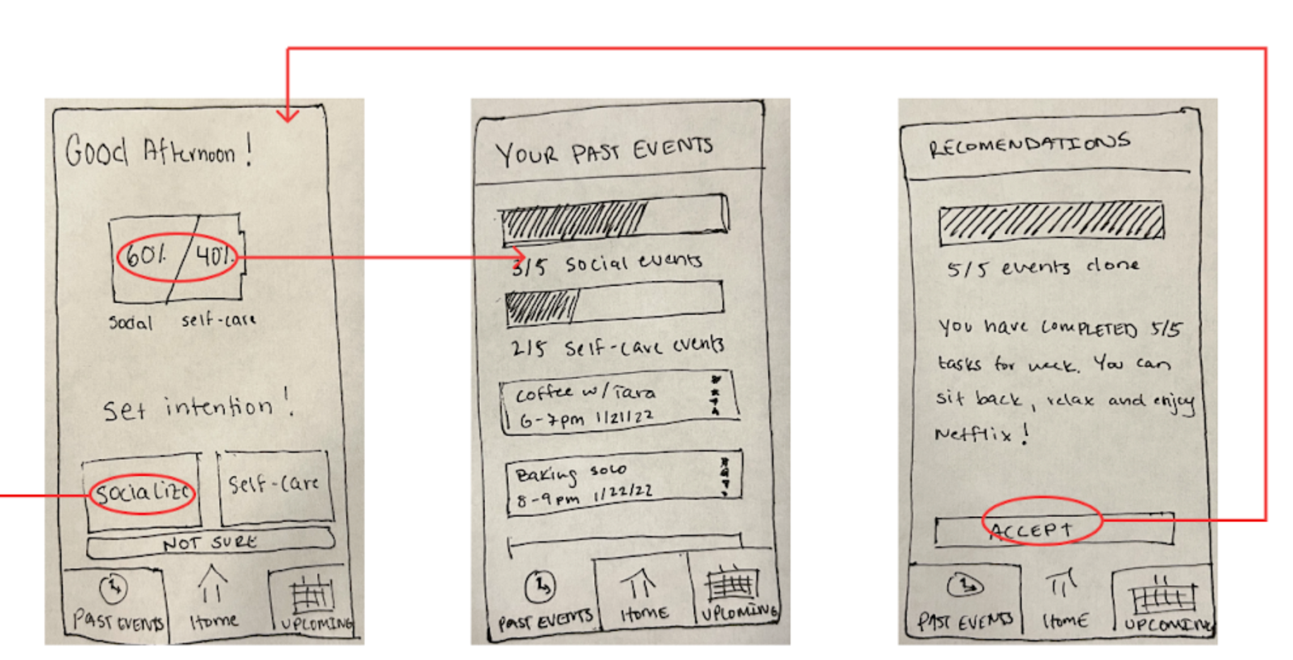
Task #1:
Users are prompted to set their intention for the day by choosing a time and place.

Slide 7
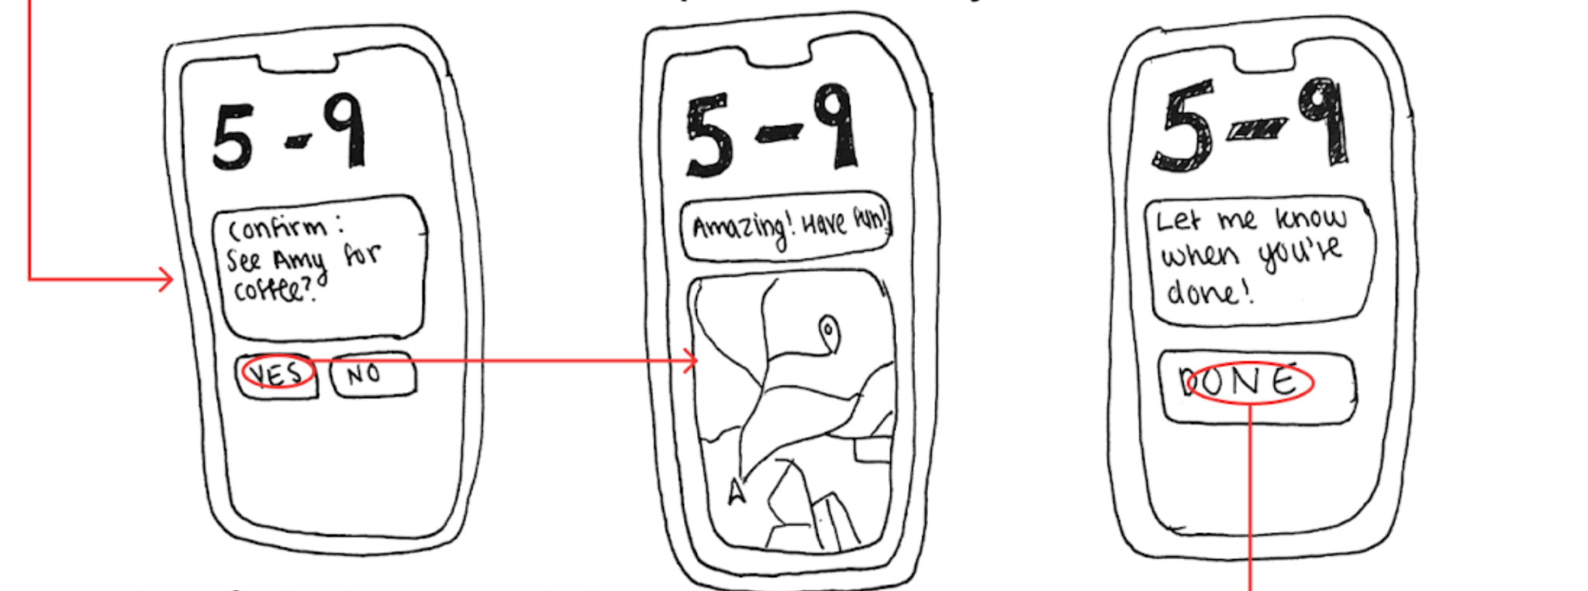
Task #2:
Users confirm plans and receive guidance and reminders to reach destination

Slide 8
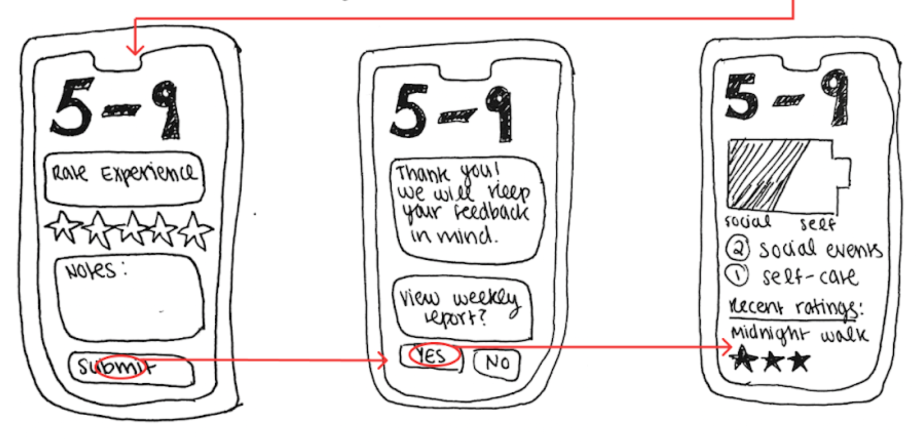
Task #3:
Users rate and provide feedback on each activity to finetune later recommendations

Slide 9
Interviews
OUR ROLES:
Tara: Facilitator
Platon/Amy: Observer
Anooshree: Notetaker
Grace
22, LA
CMC student
Suhina
24, Bay Area
Pharmacy student
Bryce
23, NYC
Consultant
Our Roles: Tara: Facilitator, Platon/Amy: Observer, Anooshree: Notetaker
Notes:
Platon
I added stuff abt Hadley if u want to use it but feel free to delete - Tara

Slide 10
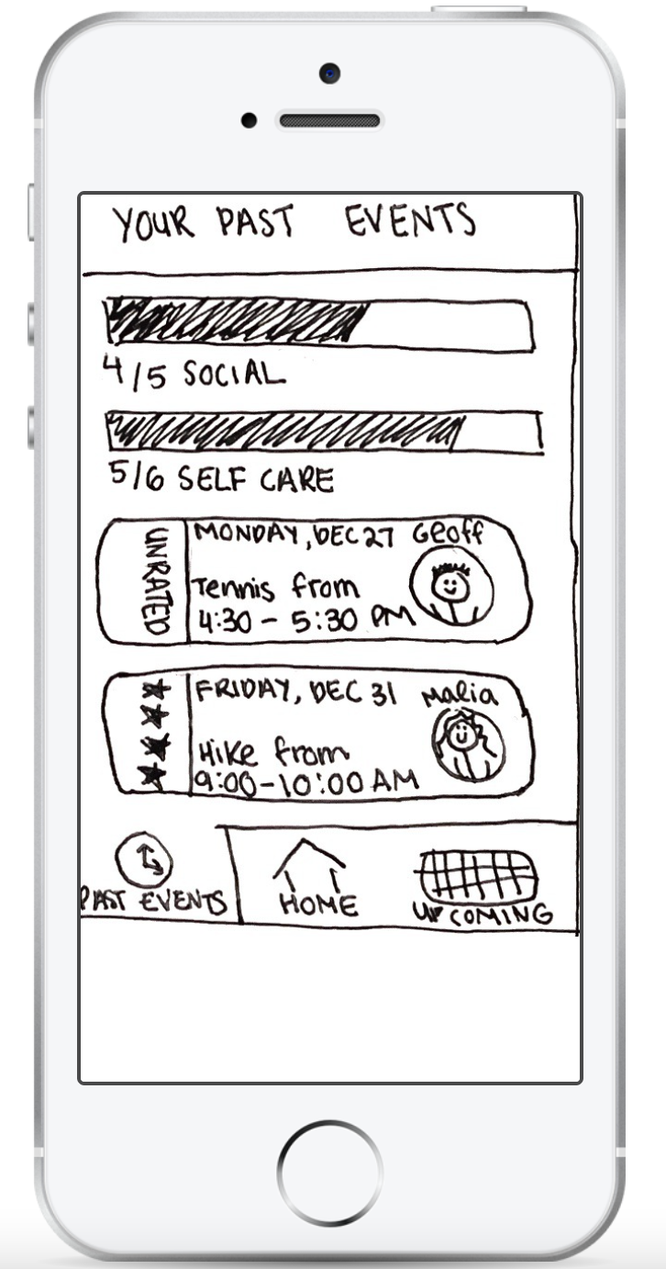
Could you try scheduling a different type of activity than the one you just scheduled?
On a scale of 1-5, how useful is it to…
…set an intention?
…do an intention?
…reflect on an intention?
Notes:
Amy

Slide 11
04
Results

Slide 12
#1: Verified our design was learnable
All three users were able to complete tasks more quickly after being exposed to the app before
user 1 time decreased by 1:45 secs,
user 2 time decreased by 1:05 secs,
user 3 time decreased by 1:13 secs
Flow of picking a time, person, then activity was viewed as intuitive
Notes:
Hadley said that, as a new grad, she’s thinking a lot about where her friends are and how she can be near them.
When college ends, “your friends are gone and your community is gone,” she says. For Hadley, that meant that after graduation she felt like she was anxiously waiting and trying to figure out where all her friends would end up. She cares about maintaining her long-term connections through big life transitions to avoid loneliness.

Slide 13
#2: Users found activities useful
Users reported that app gave the right amount of options, one user noted that this was especially helpful given that she feels indecisive when making plans
Users enjoyed being able to see specific information about the activity on the details page (map, travel time, weather)
one user noted that this was the hardest part of making plans
Notes:
Hadley said that, as a new grad, she’s thinking a lot about where her friends are and how she can be near them.
When college ends, “your friends are gone and your community is gone,” she says. For Hadley, that meant that after graduation she felt like she was anxiously waiting and trying to figure out where all her friends would end up. She cares about maintaining her long-term connections through big life transitions to avoid loneliness.

Slide 14
#3: Social battery icon was confusing
Users were confused by the meaning of and distracted by the social battery icon on the home page
Users were unsure who was in charge of setting social battery
One user noted it implies self-care is less valuable than socializing
Notes:
Hadley said that, as a new grad, she’s thinking a lot about where her friends are and how she can be near them.
When college ends, “your friends are gone and your community is gone,” she says. For Hadley, that meant that after graduation she felt like she was anxiously waiting and trying to figure out where all her friends would end up. She cares about maintaining her long-term connections through big life transitions to avoid loneliness.

Slide 15
#4: UI wasn’t fully connected between tasks
Dead end with iMessage after invitation made it impossible to return to the app without restarting the prototype
Some suggested activities did not fit well with the suggested time which confused users
Users felt that the app did not guide them towards the other two tabs of past events and upcoming events
Notes:
Hadley said that, as a new grad, she’s thinking a lot about where her friends are and how she can be near them.
When college ends, “your friends are gone and your community is gone,” she says. For Hadley, that meant that after graduation she felt like she was anxiously waiting and trying to figure out where all her friends would end up. She cares about maintaining her long-term connections through big life transitions to avoid loneliness.

Slide 16
#5: Using star-based ratings felt awkward
Setting intention and rating intention were rated comparatively lower than doing intention
Star-based rating system did not resonate with users: they had a hard time seeing how they would rate without feeling like they are rating their friend
Notes:
Hadley said that, as a new grad, she’s thinking a lot about where her friends are and how she can be near them.
When college ends, “your friends are gone and your community is gone,” she says. For Hadley, that meant that after graduation she felt like she was anxiously waiting and trying to figure out where all her friends would end up. She cares about maintaining her long-term connections through big life transitions to avoid loneliness.

Slide 17
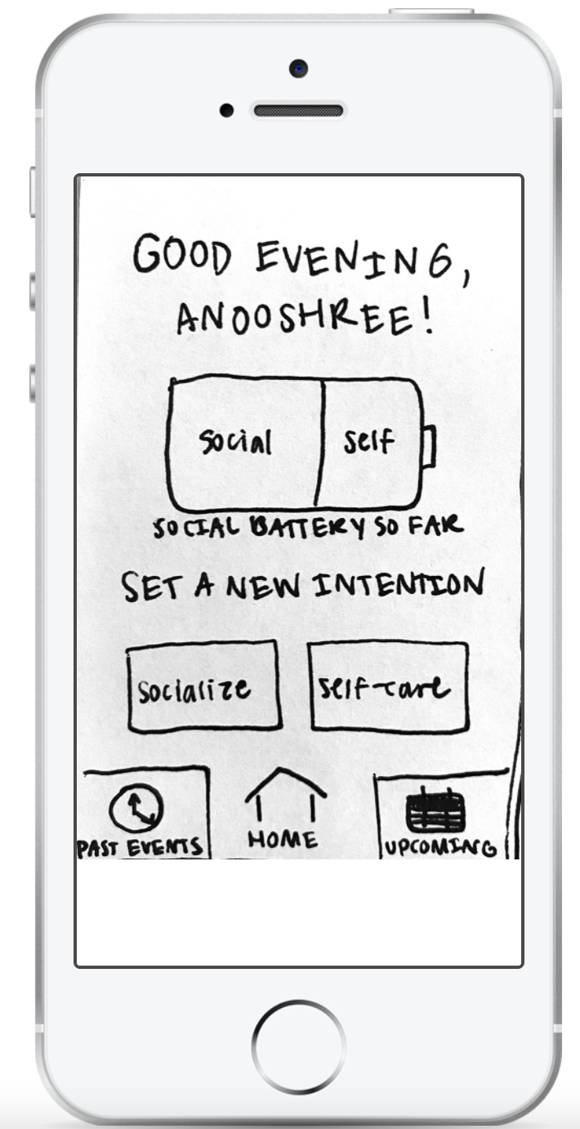
Suggested UI Changes
Change star-based rating system to mood rating system
Change to two separate batteries that track self-care and socializing and keep that in the past events tab
Create a notification icon that prompts user to rate unrated activities/view upcoming ones
Replace social battery icon with dynamic background
Notes:
Tara

Slide 18
Summary
Integrate tasks to make user experience more seamless
Explain graphics and make them intentional
Be conscientious of setting and social dynamics when planning and prompting
Notes:
Anooshree

